Slide 1




Slide 2
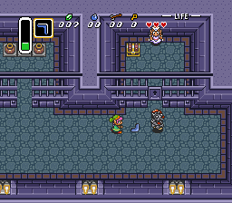
WHAT IS THIS?
2D Dungeon Crawler
¾ View
Free-roam controls
Real-time combat
Puzzles?
16-bit style
Think LoZ

Slide 3


WHO IS THIS?
Dante
Main player character
Spoopy ghost
Weak and insignificant
Finds a gauntlet one day
Proceeds to rek things

Slide 4
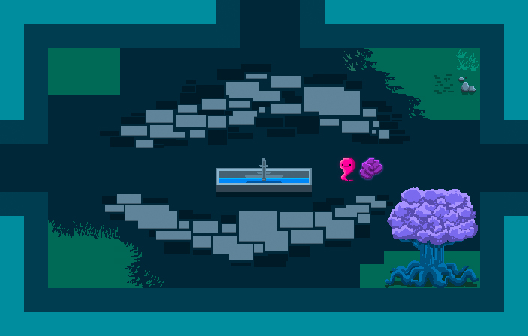
WHERE ARE WE?
Spoopy mansion
Scary courtyard
Very rooms
Many scare
Much dangers
Wow

Slide 5



WHAT WE GON’ DO?
Rek things
Don’t get rekt
Acquire points
Explore the mansion
Find the other gauntlet

Slide 6

HOW WE GON’ DO IT
Wonderful health system
Level up with XP
Allocate skill points
Learn new abilities

Slide 7





WHAT ARE WE USING
GIMP

Slide 8
DEMO TIME

